Slide 1
Longest common substring
Adham Abdelnasser Elhendawy
223419

Slide 2
Proplrm
The Longest Common Substring (LCS) problem involves finding the longest contiguous substring that is common to two given strings. In other words, given two strings, the task is to find the length of the longest sequence of characters that appears in the same order in both strings. The goal is to find common characters and to identify the longest continuous sequence of characters that occurs in both strings.

Slide 3
Strategy
Dynamic programming
DYNAMIC PROGRAMMING IS A PROBLEM-SOLVING APPROACH THAT BREAKS DOWN A COMPLEX PROBLEM INTO SIMPLER OVERLAPPING SUBPROBLEMS AND SOLVES EACH SUBPROBLEM ONLY ONCE, STORING THE SOLUTIONS TO AVOID REDUNDANT COMPUTATIONS, LEADING TO MORE EFFICIENT SOLUTIONS.

Slide 4
algorithm
The Longest Common Substring (LCS) algorithm works by comparing characters of two strings and keeping track of the length of the common substring found so far. It uses a table to store these lengths, updating it as it iterates through the characters. The final result is the longest common substring.

Slide 5
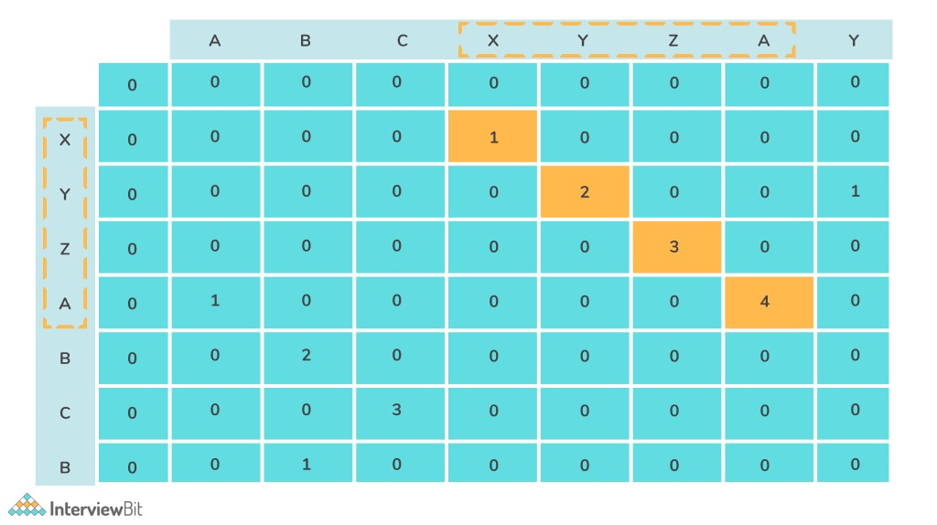

Slide 6
Implementation
def find(A, B):
lenA, lenB = len(A), len(B)
LCS = [[0] * (lenB + 1) for _ in range(lenA + 1)]
for i in range(lenB + 1):
LCS［0］= 0
for i in range(lenA + 1):
LCS[i][0] = 0
for i in range(1, lenA + 1):
for j in range(1, lenB + 1):
if A[i - 1] == B[j - 1]:
LCS［D］ = LCS［i- 110-1］+1
else:
LCSOD = 0
result = max(max(row) for row in LCS)
Return result

Slide 7



analysis
Basic operation : if A [i-1] == B [i-1]:
$$=\sum_{i=1}^{n}{\sum_{k=1}^{m}{1}}$$
T(m,n) = O(m*n)
T(n) € O(n})
T(m) € O(n)
$$\sum_{i=1}^{n}{m−1+1}$$
$$\sum_{i=1}^{n}{m}$$

Slide 8
Thank you

